Slide 1








WealthInfinity Global PVT LTD.
www.mywealthinfinity.com

Slide 2


WELCOME TO THE WORLD OF
HEALTH
WEALTH &
HAPPINESS
www.mywealthinfinity.com

Slide 3


BUILD PEOPLE
BUILD NATION
Our foundational principle is clear: by empowering individuals through holistic health practices, financial education, and entrepreneurial opportunity, we lay the groundwork for a life of true happiness and a more prosperous nation. Investing in personal well-being—from therapeutic wellness to mastering market skills—is an investment in collective success and sustainable happiness.
www.mywealthinfinity.com

Slide 4

YOUTH EMPOWERMENT
Transforming ambition into action through financial education and trading opportunities
www.mywealthinfinity.com

Slide 5




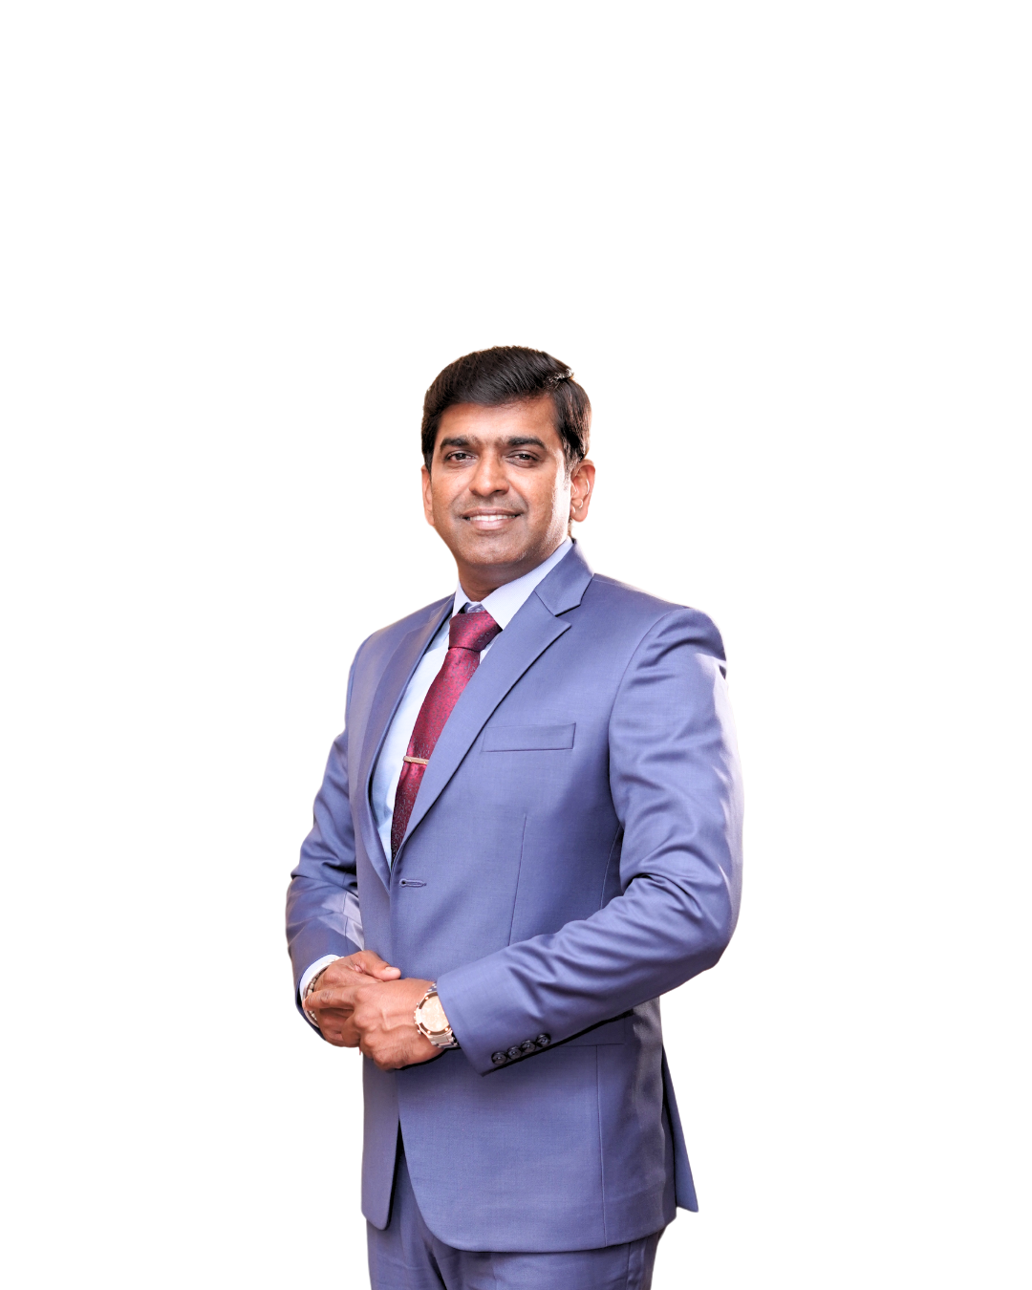
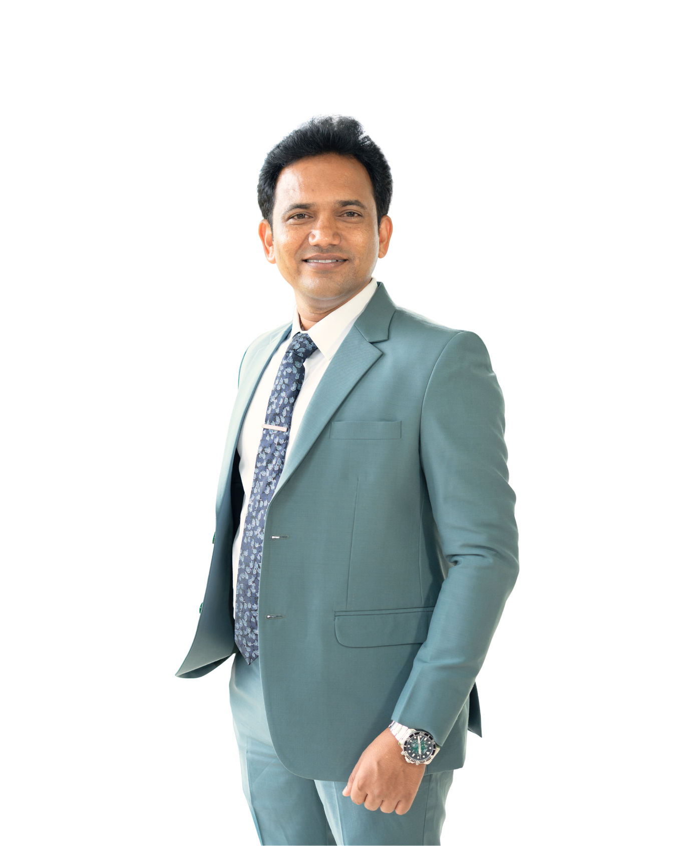

MEET THE TEAM
Mr. Prashant Salunkhe
CEO
Mr. Praveen Khatate
Mr. Vinod Shedge
CMD
Global Head
www.mywealthinfinity.com

Slide 6


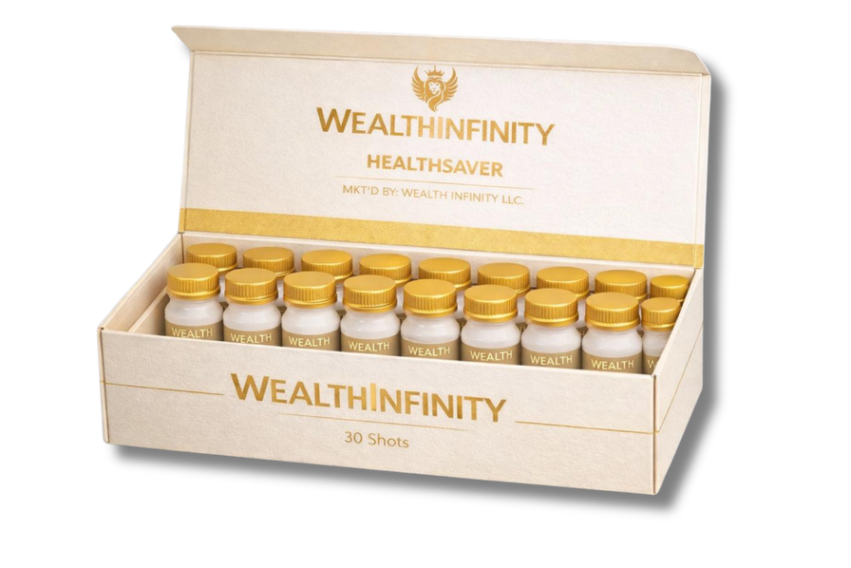
Unlock Your Potential with
HEALTHBOOST
Sea Buckthorn Juice ( 2 Bottles )
Discover comprehensive wellness solutions designed to revitalize your body and mind.
MRP: 10,000/-
DP: 6,750/-
PV: 50
HealthSaver
( 30 shots )
HealthBoost: Option 1
Sea Buckthorn Juice: 2 Bottles
HealthSaver: 30 shots
www.mywealthinfinity.com

Slide 7



Unlock Your Potential with
HEALTHBOOST
MRP: 10,000/-
DP: 6,750/-
PV: 50
HealthBoost: Option 2
Sea Buckthorn Juice: 4 Bottles
www.mywealthinfinity.com

Slide 8

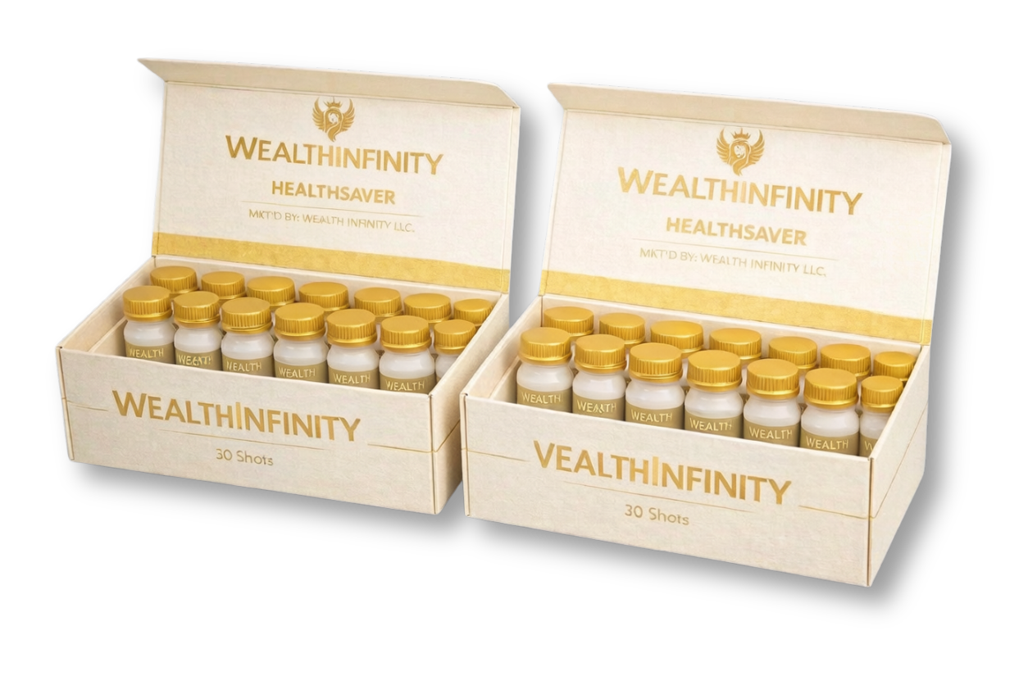
Unlock Your Potential with
HEALTHBOOST
MRP: 10,000/-
DP: 6,750/-
PV: 50
HealthBoost: Option 3
HealthSaver '30 shots: 2 Boxes
www.mywealthinfinity.com

Slide 9


Unlock Your Potential with
HEALTHBOOST
MRP: 10,000/-
Experience the subtle power of bio-magnetism for enhanced well-being.
DP: 6,750/-
PV: 50
HealthBoost: Option 4
Bio-Magnetic Bracelet: 2
Male: 1
Female: 1
www.mywealthinfinity.com

Slide 10


"Health Pro"
MRP: 19,999/-
DP: 11,500/-
PV: 90
Holistic Healing Therapy Mattress Topper
Financial Education on the Indian Stock Market
Financial Education on Currency Market
www.mywealthinfinity.com

Slide 11
"Health Pro"
MRP: 19,999/-
DP: 11,500/-
PV: 90
HealthSaver '30 shots: 2 Boxes |Sea Buckthorn Juice: 4 Bottles
Financial Education on the Indian Stock Market
Financial Education on Currency Market
www.mywealthinfinity.com

Slide 12

"HealthSkillz"
Holistic Wellness & Financial Acumen
Invest in your health and wealth with this exclusive bundle.
MRP: 19,999/-
DP: 14,927/-
PV: 100
Holistic Healing Therapy Mattress Topper
Financial Education on the Indian Stock Market
Financial Education on Currency Market
www.mywealthinfinity.com

Slide 13

"HealthNWealth Hub"
Ultimate Wellness & Financial Growth
Holistic Healing Therapy Mattress Topper
Bio-Magnetic Bracelet - 2
Water Energy Pad
Pain Relief Belt
Sea Buckthorn Juice - 2 Bottles
MRP: 36999
DP: 29500
PV: 200
PLUS, GET EXCLUSIVE EXCESS OF
Financial Education on Indian Stock Market
Financial Education on Currency Market
www.mywealthinfinity.com

Slide 14

Financial
Education
Provider
www.mywealthinfinity.com

Slide 15



Stock
Market
NSE
BSE
NATIONAL STOCK EXCHANGE
BOMBAY STOCK EXCHANGE
www.mywealthinfinity.com

Slide 16

Currency Market
Global Markets
High Liquidity
Trade currencies 24/7 across international markets
Access the world's largest financial market
www.mywealthinfinity.com

Slide 17

We Are Providing World Class Education
Planning
Advance Price Action
www.mywealthinfinity.com

Slide 18


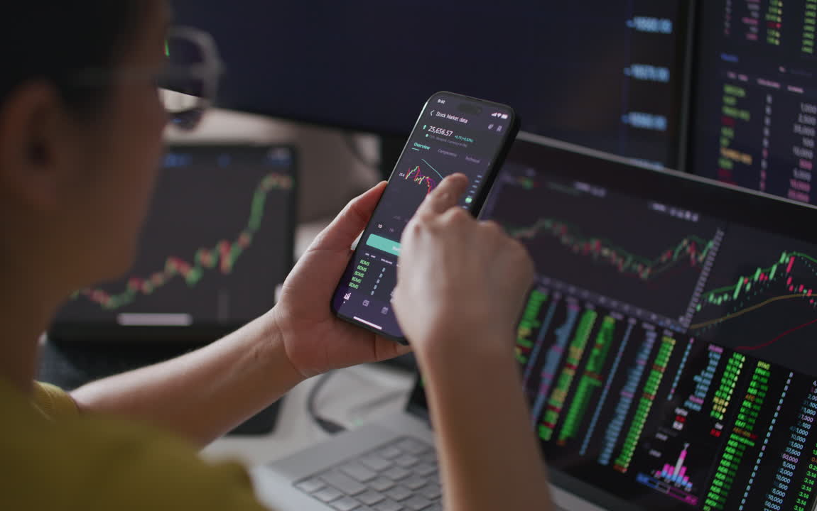
Trading
Support
Group
www.mywealthinfinity.com

Slide 19

Direct Selling Industry
Word of Mouth Publicity
The global direct selling Industry's turnover for 2024 was Approximately $163.9 billion.
Indian direct selling Industry achieved a turnover of 22142 crore in FY 24
India's direct selling Industry is expected to reach 1.8 lakh crore by 2030
India's direct selling Industry is expected to attract a significant number of youth by 2030
www.mywealthinfinity.com

Slide 20
5
Pathways to Income Generation
01
02
03
Retail Profit
Direct Sponsor Bonus
Business Matching Bonus
04
05
Sponsor Matching Bonus
Rank And Rewards
www.mywealthinfinity.com

Slide 21

Retail Profit
Your Immediate Earnings
Earn directly from every sale, rewarding your effort and dedication.
www.mywealthinfinity.com

Slide 22

Direct Sponsor Bonus
Empowering Growth
1
50 PV: ₹ 500
2
90 PV: ₹ 1000
3
100 PV: ₹ 2000
4
200 PV: ₹ 4000
www.mywealthinfinity.com

Slide 23
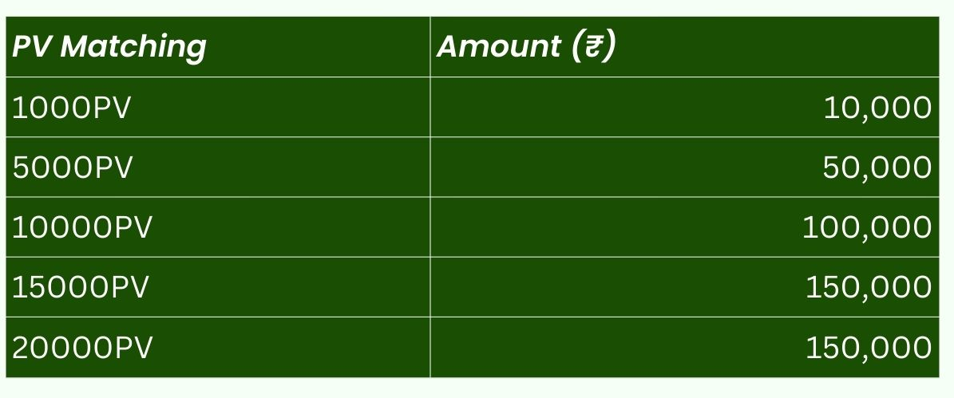
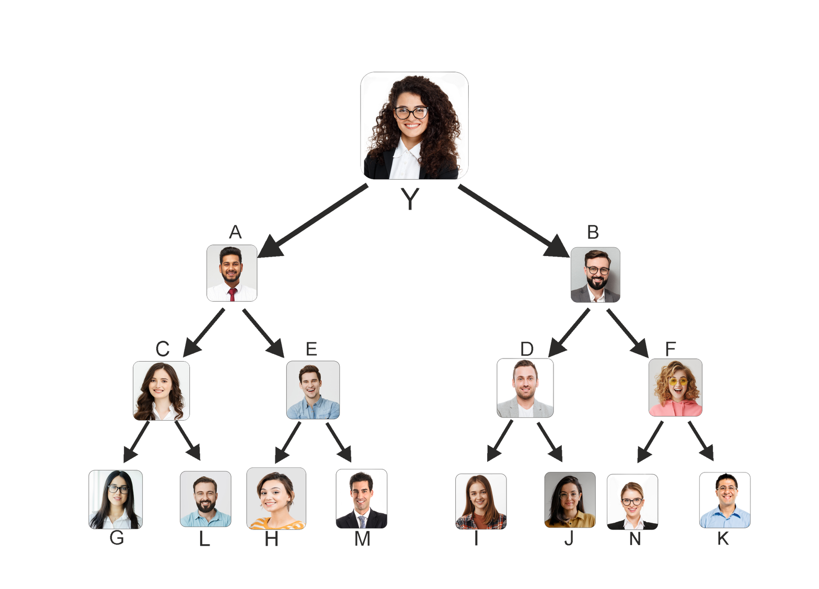
Business Matching Bonus
WEEKLY CAPPING
{ 100 PV }
{ 100 PV }
₹ 1,50,000
MONTHLY CAPPING
₹ 6,00,000
{ 100 PV }
{ 50 PV }
{ 100 PV }
{ 200 PV }
YEARLY CAPPING
₹ 72,00,000
{ 50 PV }
{ 90 PV }
www.mywealthinfinity.com

Slide 24
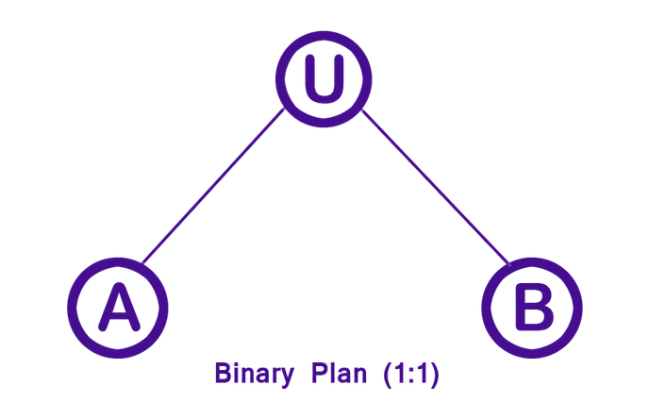
Sponsor Matching Bonus
1ST LEVEL DIRECTS: 25%
You receive 25% of the Business Matching Bonus earned by individuals you directly sponsor.
EXAMPLE:
If "A" (your direct) earns ₹1,00,000 in Business Matching Bonus, you will receive ₹25,000.
2ND LEVEL DIRECTS: 25%
Powerful Earning Potential:
If you have 10 direct referrals who collectively earn ₹6,00,000 per month in Business Matching Bonus, you could earn up to ₹15,00,000 per month. Now imagine duplicating those 10 directs, each brings 10 more leaders, creating a team of 100 high performers. If each of those 100 earns ₹6 lakh per month, the total team business becomes ₹6 Crore.
At a 25% matching bonus, your monthly income scales to ₹1.5 Crore.
This is the true power of leveraged growth — build leaders, duplicate performance, and transform ₹1.5 lakh into ₹1.5 Crore through structured expansion.
You receive 25% of the Business Matching Bonus earned by individuals sponsored by your direct referrals.
EXAMPLE:
If "B" (sponsored by your direct "A") earns ₹1,50,000 in Business Matching Bonus, you will receive ₹37,500.
www.mywealthinfinity.com

Slide 25
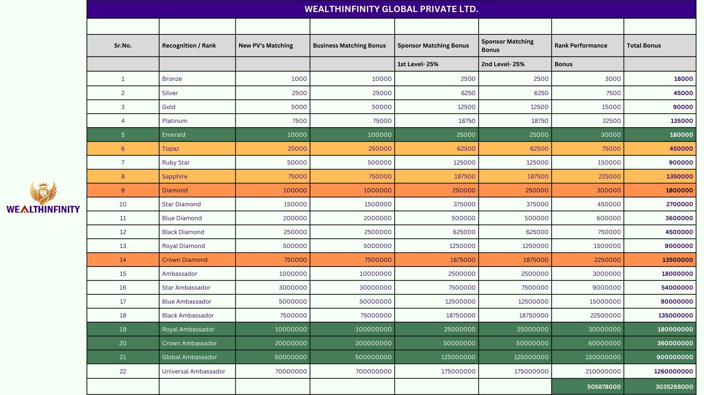

Slide 26
Important Disclaimer
Our wellness products, including the "HealthBoost," "HealthSkillz," and "HealthNWealth Hub" packages, all items such as the Holistic Healing Therapy Mattress Topper, Bio-Magnetic Bracelets, and nutritional supplements, are intended to support general well-being.
These products are not intended to diagnose, treat, cure, or prevent any disease.
Wealthinfinity is not a fund management company and does not provide any portfolio or fund management services. All information, training, tools, and content provided by Wealthinfinity, including our financial education modules on the Indian Stock Market and Currency Market, are purely for educational purposes.
Our mission is to empower individuals through learning; however, investments and trading in financial markets are subject to significant market risks. Past performance is not indicative of future results.
www.mywealthinfinity.com

Slide 27




Follow Us On Socials
Wealthinfinity Official-YouTube
Wealthinfinityofficial- Instagram
WealthInfinity- Facebook
www.mywealthinfinity.com

Slide 28

Thank You!
Connect With Us and Start Networking with Confidence.
www.mywealthinfinity.com

